Slide 1
Threads
CS-502
Spring 2006

Slide 2
Problem – Unix/Windows Processes are Heavyweight
Lots of data in process context
    Even more when we study memory management
    More than that when we study file systems, etc.
Processor caches a lot of information
    Memory Management information
    Caches of active pages
Costly context switches and traps
    100’s of microseconds

Slide 3
Problem – Unix/Windows Processes are Heavyweight (continued)
Separate processes have separate address spaces
    Shared memory is limited or nonexistent
    Applications with internal concurrency are difficult
Isolation between independent processes vs. cooperating activities
    Fundamentally different goals

Slide 4
Example
Web Server – want to handle multiple concurrent requests – How?
One solution:
  create several processes that execute in parallel
  Use shared memory (shmget() ) to map to the same address space in the processes
  have the OS schedule them in parallel
Not efficient
  space: PCB, page tables, etc.
  time: creating OS structures (fork() ) and context switch

Slide 5
Example 2
Transaction processing systems – e.g, airline reservations
1000’s of transactions per second
Separate processes per transaction are too costly
Other techniques (e.g., message passing) are much more complex

Slide 6
This problem …
… is partly an artifact of
    Unix, Linux, and Windows
    Big, powerful processors (e.g., Pentium 4)
… tends to occur in most large systems
… is infrequent in small-scale systems
    PDAs, cell phones, hand-held games
    Closed systems (i.e., controlled applications)

Slide 7
Solution:– Threads
A thread is the execution of a program or procedure within the context of a Unix or Windows process
    I.e., a specialization of the concept of process
A thread has its own
    Program counter, registers, PSW
    Stack
A thread shares
    Address space, heap, static data
    All other resources
with other threads in the same process

Slide 8
Threads
thread 1 stack
SP (T1)
0xFFFFFFFF
thread 2 stack
SP
SP (T2)
thread 3 stack
SP (T3)
Virtual
address space
heap
static data
0x00000000
PC
code
(text)
PC (T2)
PC (T1)
PC (T3)

Slide 9
Thread Interface
This is taken from the POSIX pthreads API:
  int pthread_create(pthread_t *thread, const pthread_attr_t *attr, void*(*start_routine) (void), void *arg) ;
    creates a new thread of control
    new thread begins executing at start_routine
  pthread_exit(void *value_ptr)
    terminates the calling thread
  pthread_join(pthread_t thread, void **value_ptr);
    blocks the calling thread until the thread specified terminates
  pthread_t pthread_self()
    Returns the calling thread's identifier

Slide 10
Threads
Linux, Windows, and various versions of Unix have their own thread interfaces
    Similar, not standardized
Some issues
    E.g., ERRNO in Unix — a static variable set by system calls

Slide 11
Unix Processes vs. Threads
On a 700 Mhz Pentium running Linux
  Processes:
    fork()/exit() - 250 microsec
  Kernel threads:
    pthread_create()/pthread_join(): 90 microsec
  User-level threads:
    pthread_create()/pthread_join(): 5 microsec

Slide 12
Threads – Management
Who/what creates and manages threads
  Kernel level – new system calls and new entity to manage (Linux (called lightweight process), Win/NT (threads))
  User level
    done with function library (Posix)
    Runtime system – similar to process management except in user space
    Win/NT - fibers

Slide 13
Threads – User Space
Can be implemented without kernel support
    … or knowledge!
Program links with a runtime system that does thread management
    Operation are efficient (procedure calls)
    Space efficient and all in user space (TCB)
    Task switching is very fast
Since kernel not aware of threads, there can be scheduling inefficiencies
    E.g., blocking I/O calls

Slide 14
Threads – User Space
Thread Scheduler
  Queues to keep track of threads’ state
  Scheduler – non-preemptive
    Assume threads are well-behaved
    Thread gives up CPU by calling yield() – does context switch to another thread
  Scheduler – preemptive
    Assumes threads may not be well-behaved
    Scheduler sets timer to create a signal that invokes scheduler
    Scheduler can force thread context switch
    Increased overhead

Slide 15
Threads – Kernel Space
OS schedules threads instead of processes
Benefits
  Overlap I/O and computing in a process
  Creation is cheaper than processes
  Context switch can be faster than processes
Negatives
  System calls (high overhead) for operations
  Additional OS data space for each thread

Slide 16
Threads – supported by processor
E.g., Pentium 4 with Hyperthreading™
    www.intel.com/products/ht/hyperthreading_more.htm
Multiple CPU’s on a single chip
    True concurrent execution within a single process
Requires kernel support
Re-opens old issues
    Deadlock detection

Slide 17
Mutual Exclusion within Threads
extern void thread_yield();
extern int TestAndSet(int &i);
/* sets the value of i to 1 and returns the previous value of i. */
void enter_critical_region(int &lock) {
while (TestAndSet(lock) == 1)
thread_yield(); /* give up processor */
};
void leave_critical_region(int &lock) {
lock = 0;
};

Slide 18
Threads inside the OS kernel
Kernels have become big, multi-threaded programs.
Lots of concurrent activity
    Multiple devices operating at one time
    Multiple user activities at one time
A useful tool
    Special kernel thread packages, synchronization primitives, etc.
    Useful for complex OS environments

Slide 19
Threads – Summary
Processes are very heavyweight in Unix, Linux, Windows, etc.
    Need for isolation between processes at odds with desire for concurrency within processes
Threads provide an efficient alternative Thread implementation and management strategies depend upon expected usage
    Kernel support or not
    Processor support or not

Slide 20
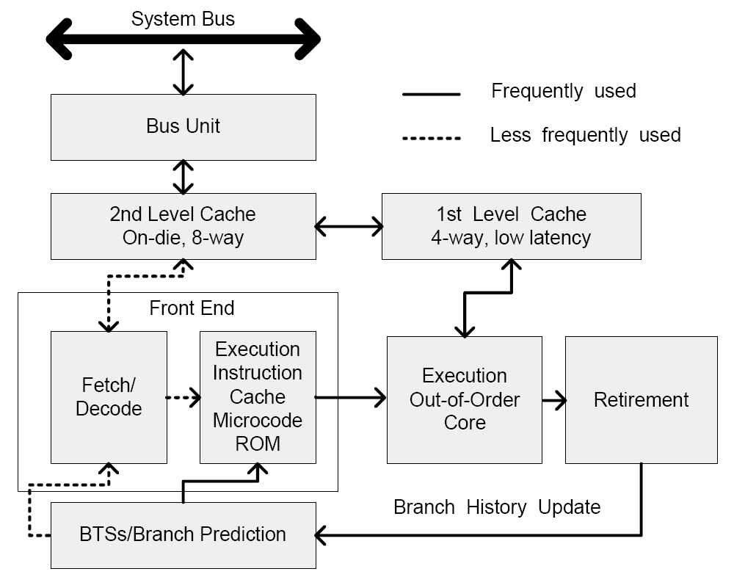
IA-32 Intel® Architecture
Software Developer’s Manual
(Figure 2-1)

